Slide 1
vim
a beginner’s journey to coding awesomely:w

Slide 2

who am i?
kyle tolle
ambitious software developer
@kyletolle
nullsix.com
github.com/kyletolle

Slide 3
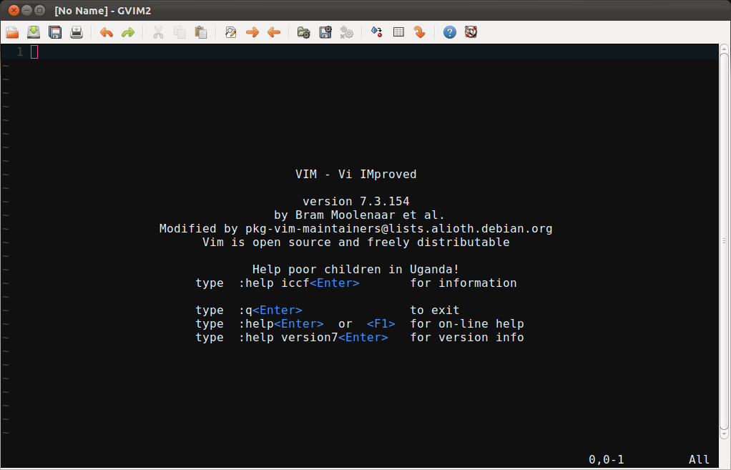
vim

Slide 4
what is vim?
highly configurable text editor
improved version of the vi editor
perfect for lazy devs
muscle memory maker

Slide 5
what isn’t vim?
not a word processor
not a hand holder
not a tool learned in a week
never gonna let you down

Slide 6
begin
install
run vim or gvim
learn, learn, learn
vimtutor (from the cli)
:help user-manual or :help quickref
tweak

Slide 7
1st things 1st
what are some common things you do while editing text, code, config files, etc?
open vimtutor or a file to learn by doing!

Slide 8
normal mode
you’re in normal mode by default
move around and perform commands
not for typing text
<ESC> gets you back to normal mode from any other mode
Ctrl-[ is equivalent, less hand movement

Slide 9
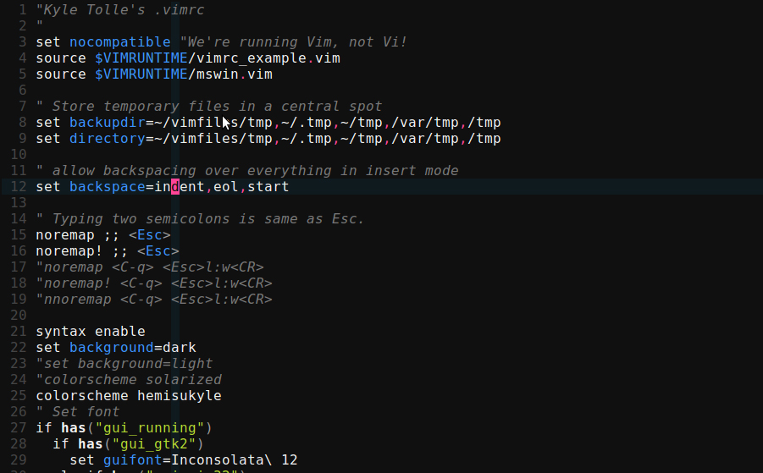
normal cursor

Slide 10
move around
^
k
< h
l >
j
v

Slide 11
what?
vim is a muscle memory
can use arrow keys but i’m lazy
trust in the vim - it’ll be faster

Slide 12
insert mode
i - insert before cursor
type in whatever you’d like
<ESC> to get back to normal mode
u to undo
get used to hitting <ESC> after editing text so
you’ll always end in normal mode
:help i

Slide 13
insert mode
i - insert before cursor
a – insert after cursor
I – insert at start of line
A – append to end of line
:help A

Slide 14
see the pattern?
a letter does something
shift modifies it in some way
ctrl also modifies some keys
vim is full of patterns

Slide 15
un-pattern
H,J,K,L are oddities
J joins lines, which is handy
use :help for others

Slide 16
help is helpful
type one of the following
:help i
:help I
use :help to figure out things do
tab completion works here!
Ctrl-d is another way to show completion options
:help c_Ctrl-d

Slide 17
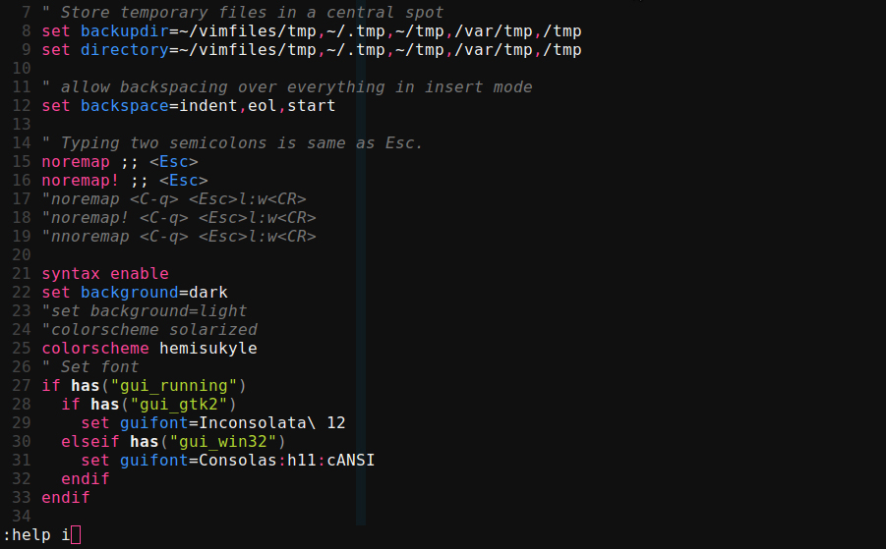
typing command

Slide 18
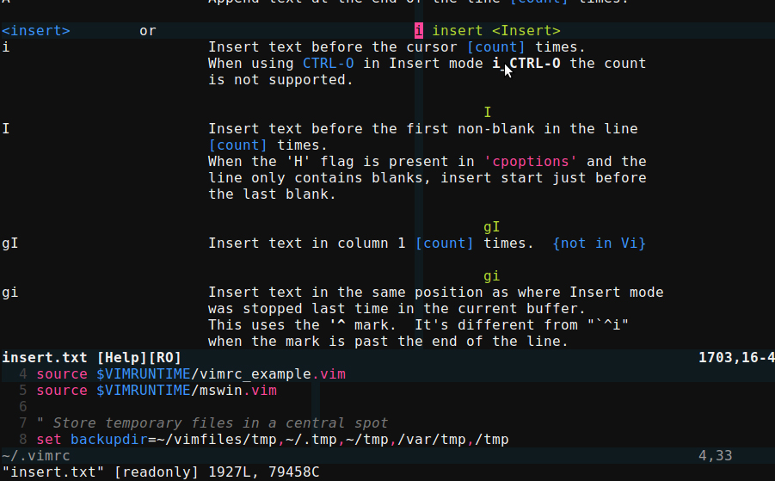
help split

Slide 19
help split
the :help command split the window
we’ll learn more about this later
for now, know that :q closes it
use :help on keys as we go
:help :help

Slide 20
editing
x – delete char under cursor
r{char} – replace char under cursor with {char}
R – replace multiple characters, starting with char under cursor
. – repeat last command
:help R

Slide 21
writing file
we made some changes we want to save
:w writes the file
if not in normal mode, :w’s may appear in your file!
:help :w

Slide 22
commands
from normal mode, type :
:w - write
:q - quit
:e – edit (without arguments reloads current file)
append a ! to force the command
:wq is common
:help :e

Slide 23
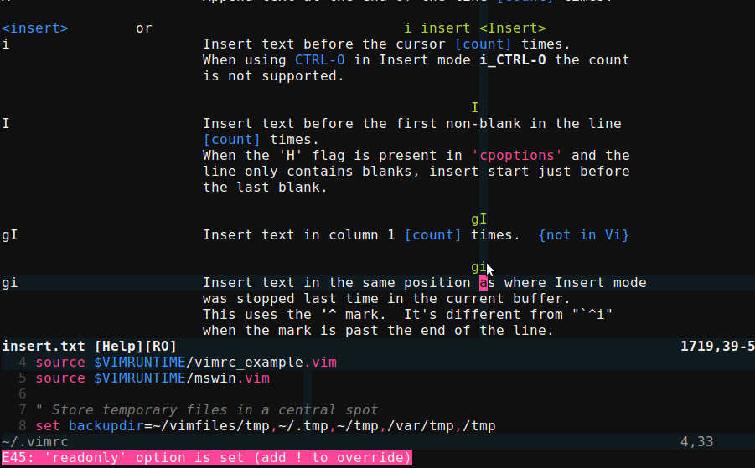
readonly msg

Slide 24
motions
move around the file with certain motion keys
w – start of next word
e – end of this word
b – back a word
use help to find out what W,E,B do

Slide 25
more motions
^ - first non-blank char on this line
$ - end of this line
0 – first character of this line
:help ^

Slide 26
more motions
gg – beginning of file
G – end of file
h,j,k,l are movements too
:help gg

Slide 27
bigger picture
pair motions with commands
general formula is
{#}command{motion}
perform the command this many times
what command to perform
what motion to perform the command over

Slide 28
commands
manipulate text from normal mode
{#}d{motion} – delete
{#}c{motion} – change
. repeats the last command
feels good to be lazy!

Slide 29
linewise commands
work on whole line
dd - delete
cc - change
yy - yank
>> - indent
<< - de-indent

Slide 30
oops
u – undo
U – undo all changes made to this line
Ctrl-r – redo
:help Ctrl-r

Slide 31
copy/paste
{#}y{motion} – yank
p – paste after cursor
P – paste before cursor
:help P

Slide 32
new lines
o – insert new line below current
O – insert new line above current
puts you in insert mode as well
:help o

Slide 33
a word, inner word
eg. you’re at the end of the word, but want to delete the whole word without moving cursor back
daw – delete a word - also deletes whitespace following word
diw – delete inner word - only deletes text; leaves whitespace
:help aw or :help iw

Slide 34
power
there are a ton of possibilities
3dk – delete 3 lines up
5,10y – yank lines 5 through 10
try chaining commands

Slide 35
autocomplete
in insert mode, type first part of word, then press
Ctrl-n - insert next matching word
Ctrl-p – insert previous matching word
repeat to cycle through matches
:help i_ctrl-n

Slide 36
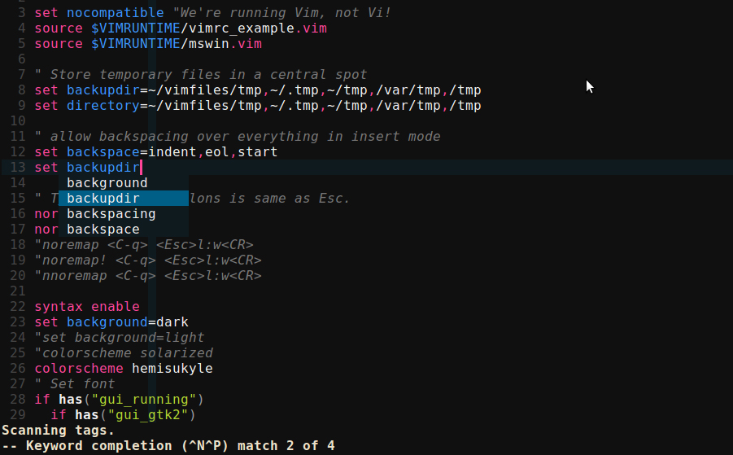
autocomplete

Slide 37
jumping around
Ctrl-f – jump forward a screen
Ctrl-b – jump backward a screen
:{#} - to go to line #
Ctrl-o – follow breadcrumb backward
Ctrl-i – follow breadcrumb forward
:help Ctrl-o

Slide 38
searching
/{text} - search forward
?{text} – search backward
n – repeat search in that direction
N – repeat search in opposite direction
:help /

Slide 39
searching
Searches wrap around file start/end
* - search forward for word under cursor
# - like * but backward
n and N work for repeating
:help *

Slide 40
improving search
:set ignorecase – case insensitive
:set smartcase – ignore case only if all lowercase
:set incsearch – shows first matching word as you type
add these lines (without semicolons) to .vimrc to have them be defaults
:help set

Slide 41
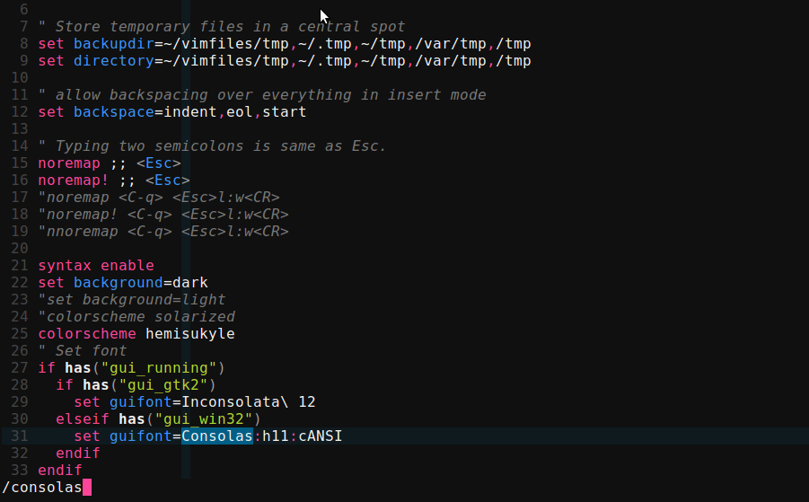
incsearch

Slide 42
search highlight
:set hlsearch – highlights search term througout the file
:noh – no highlight – clears highlights if you no longer want them displayed

Slide 43
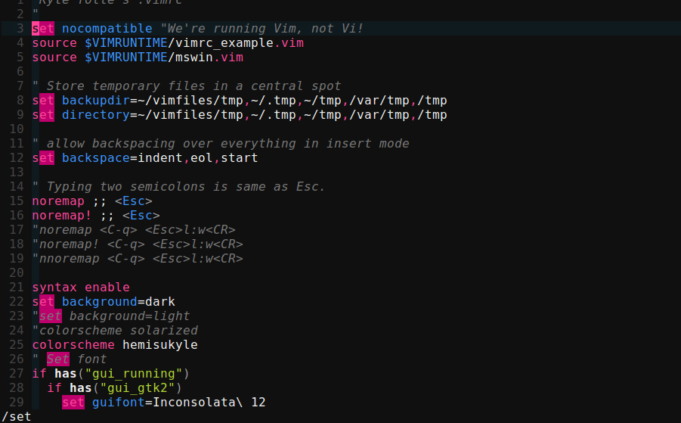
hlsearch

Slide 44
substitution
:s/old/new – replace first occurrence of old with new on this line
add flags to the end:
:s/old/new/gc
g – global - replaces all occurrences on line
c – confirmation - prompts confirmation each time
:help :s_flags

Slide 45
substitution
:%s/old/new/g – replace all occurrences of old with new in whole file
:%s/old/new/ - replace first occurrence of old with new on all lines in whole file
& - repeat last substitution
:help &

Slide 46
buffers
each file opened is its own buffer
might only be viewing one buffer but the others are still open
switch between buffers
show buffers in different windows
:help :buffer

Slide 47
buffers
:e {filename} – edit filename in current window - creates new buffer
:ls – show buffers
:b{#} - switch to buffer #
:bn,:bp – buffer next/previous
:bd – buffer delete
:help :bd

Slide 48
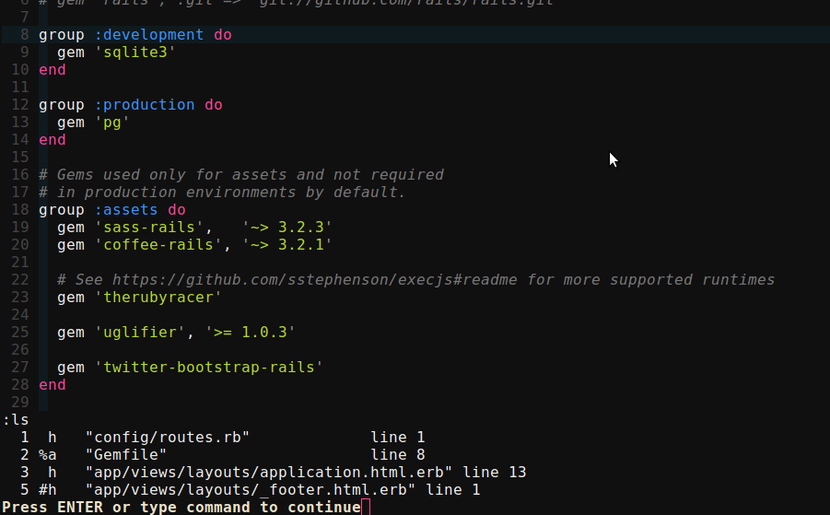
:ls

Slide 49
buffer/file info
Ctrl-g or :f shows
current file name
cursor position
file status (read-only, modified, etc)
helpful to get bearings when switching between buffers
:help Ctrl-g

Slide 50
windows
:help {foo} splits the window
show multiple buffers at same time
eg. edit spec/code side by side

Slide 51
splitting windows
can split the edit area multiple ways
:sp(lit) - horizontal
:vs(plit) – vertical
:q closes current window
buffer still exists
:help :vs

Slide 52
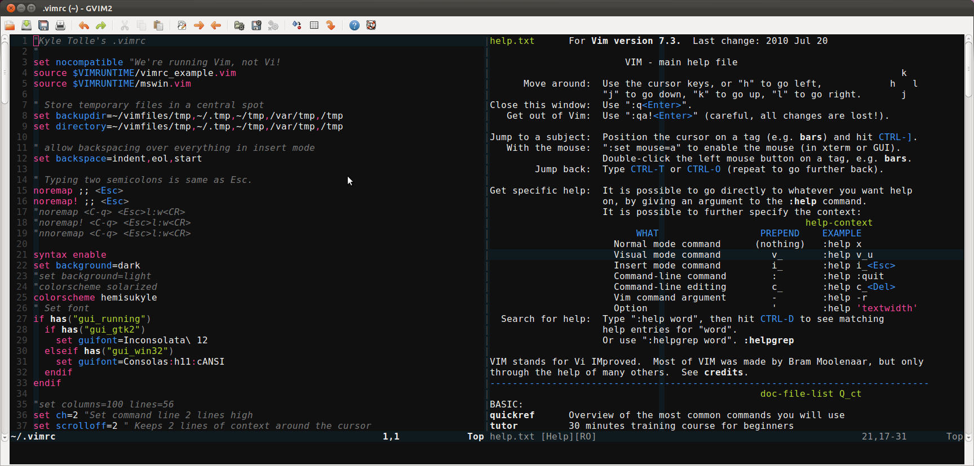
vsplit

Slide 53
window commands
Ctrl-w w - cycles between windows
Ctrl-w h,j,k,l - moves to window in that direction
:help Ctrl-w for more commands

Slide 54
visual mode
one of many modes
starts a highlighted area
v – visual mode per character
V – visual mode linewise
Ctrl-v – visual mode blockwise
:help v

Slide 55
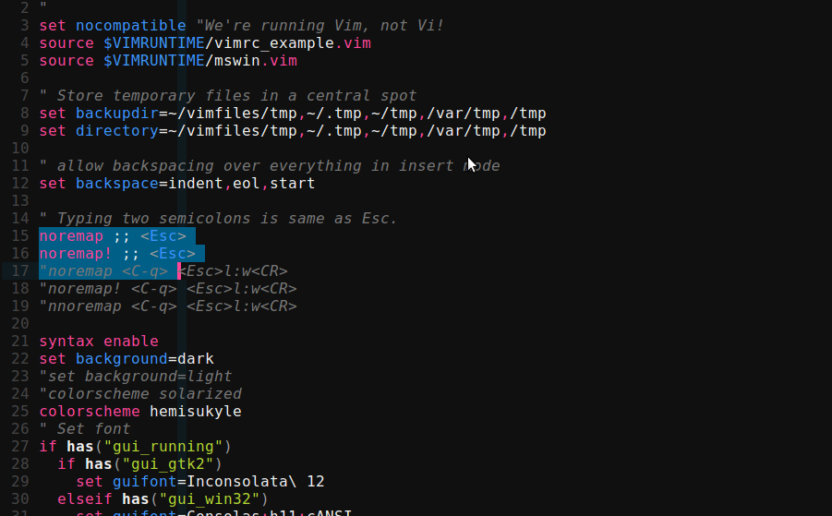
visual mode

Slide 56
visual mode
once visual mode is selected, use motions to expand the highlighted text
V j – selects this line and 1 below
after selected, use a command
delete/yank/substitute/etc
performed only to the selected area

Slide 57
.vimrc
file containing vim customizations
see my .vimrc in my dotfiles repo
https://github.com/kyletolle/dotfiles
other people share their vimrcs
mix and match as you choose

Slide 58
create .vimrc
:e ~/.vimrc – unix
:e $VIM/_vimrc – windows
:r $VIMRUNTIME/vimrc_example.vim
:w to write the file
:help vimrc-intro

Slide 59
colorschemes
many come with vim
solarized is a popular one
color packs you can download
make your own!

Slide 60
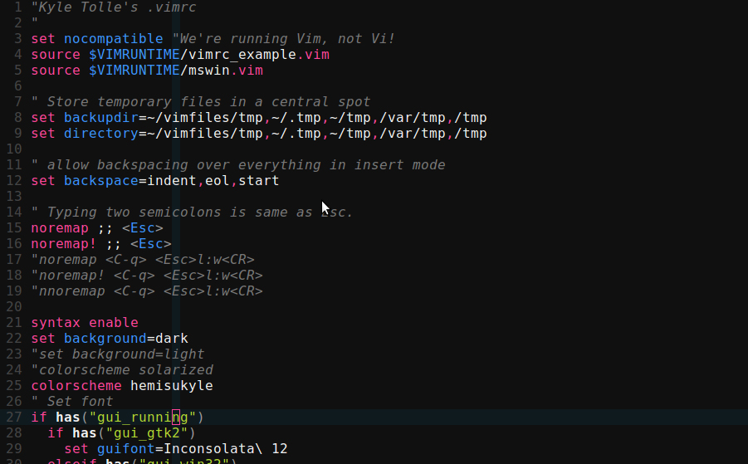
mine

Slide 61
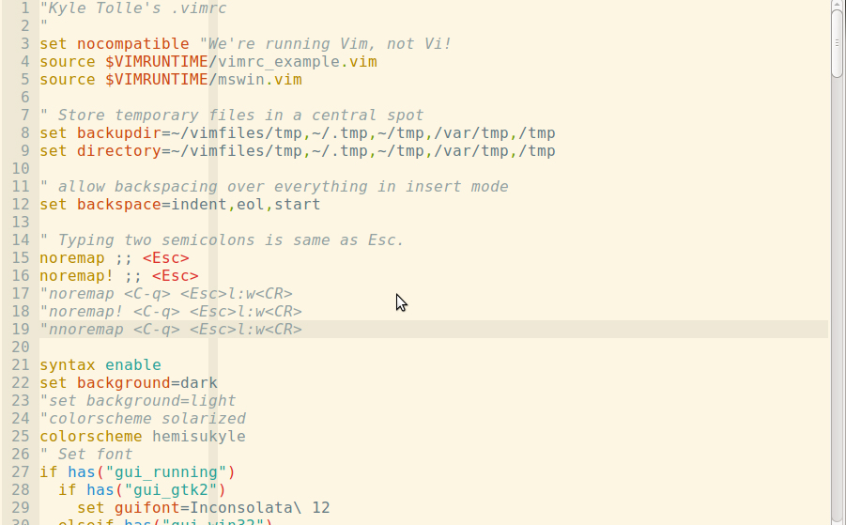
solarized

Slide 62
more motions
f{char} – moves cursor forward (right) to first occurrence of char
F{char} – like f, but to the left
:help f

Slide 63
more motions
t{char} – moves cursor forward just before first occurrence of char
T{char} – like t, but to the left
; - repeat latest f,F,t,T
, - repeat latest f,F,t,T in opposite direction
:help ;

Slide 64
advanced
filetypes
language support
syntax highlighting
other modes

Slide 65
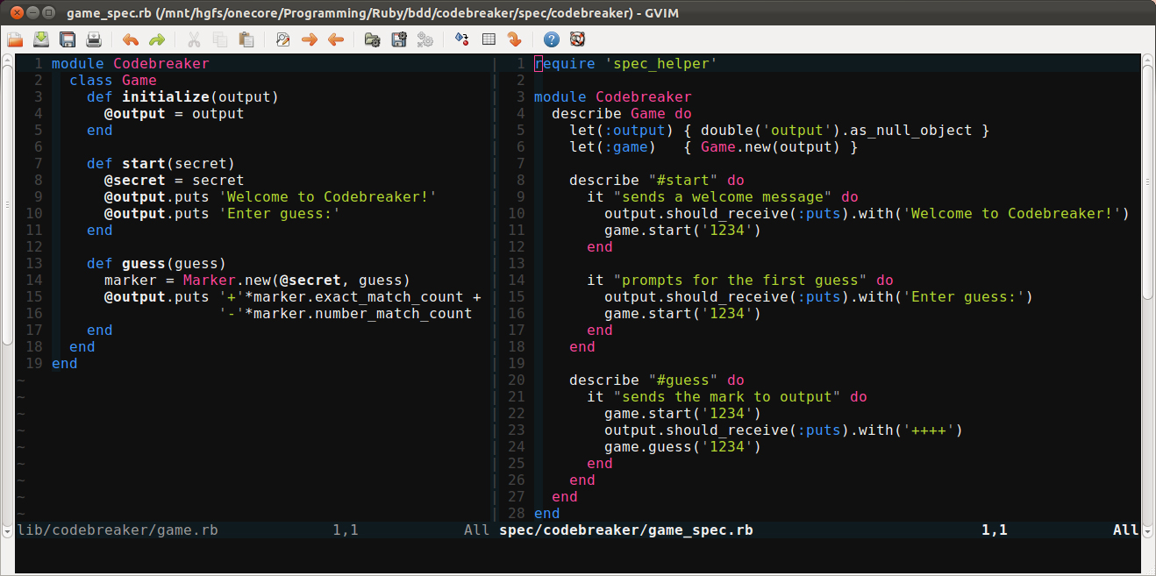
ruby

Slide 66
advanced
gvimdiff file1 file2
commands related to diffing/merging files
folds
collapse blocks of code
marks – jump around file easier
ma – mark the current like as a
‘a – jump to mark a
Ctrl-o, Ctrl-i – jump backward and forward to last places you were

Slide 67
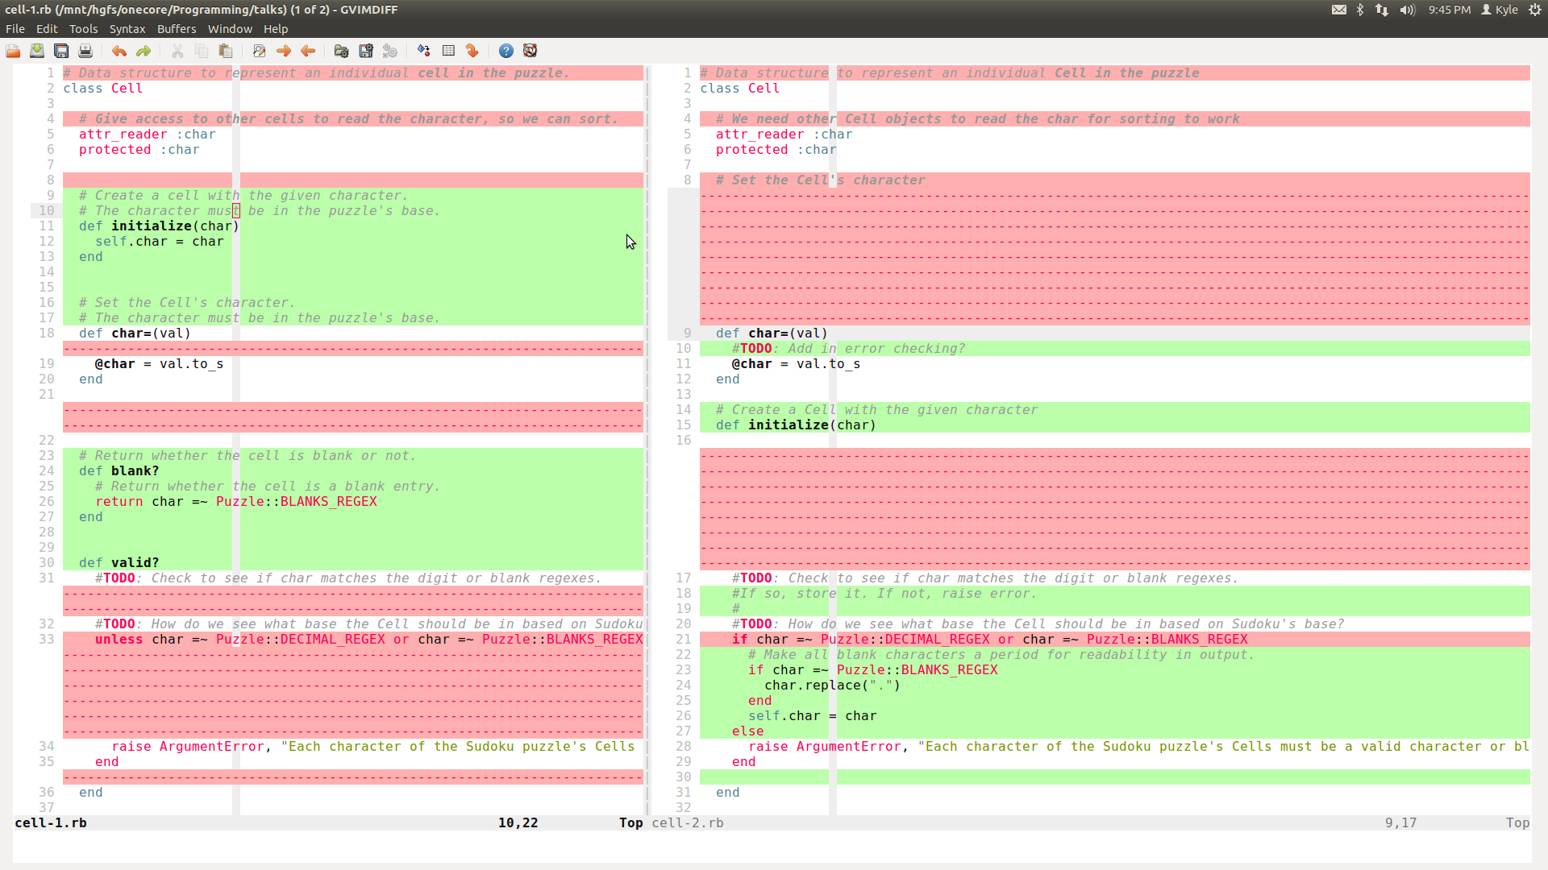
gvimdiff

Slide 68
advanced
. – refers to current line
% - refers to current file
ranges for commands
examples:
:> - indent this line
:.> - indent this line
:.,+2> – indent this and the next two lines
:.,’a>> - indent two times from this line until mark a
:%>> indent this whole file two times
:help :range

Slide 69
advanced
macros
repeat a series of actions that you record
key mapping
customize things as you like
plugins
Command-T for fuzzy file finding

Slide 70
advanced
registers
deleting or yanking puts content into default registers
can specify other registers though
tabs
different view/window layout of the open buffers
matching
% - match current punctuation
see if {}, (), do/end, etc. match up properly

Slide 71
references
http://www.vim.org
http://vim.wikia.com
get a copy of this talk
https://github.com/kyletolle/talks
cheatsheet
http://simpletutorials.com/tutorials/vim/vimquick.pdf

Slide 72
questions?
thanks for showing up!
i appreciate any and all feedback!
improve your vimfoo!

